Slide 1

AWS-Elastic Container Service(ECS)
Prepared by:
Ms. Avita Katal
Assistant Professor (SG)
School of Computer Science
UPES, Dehradun

Slide 2
Amazon Elastic Container Service (ECS)
Amazon Elastic Container Service (Amazon ECS) is a fully managed container orchestration service that simplifies your deployment, management, and scaling of containerized applications.
Simply describe your application and the resources required, and Amazon ECS will launch, monitor, and scale your application across flexible compute options with automatic integrations to other supporting AWS services that your application needs.
Perform system operations such as creating custom scaling and capacity rules, and observe and query data from application logs and telemetry.

Slide 3
Features of ECS
Launch containers on AWS at scale without worrying about the underlying infrastructure.
Reduce costs with automatic scaling and pay-as-you-go pricing across multiple AWS compute options.
Deploy faster and focus on your applications by using Amazon ECS with AWS Fargate serverless compute for containers.
Build on Amazon ECS with confidence, knowing that the security, compliance, and architecture meet regulatory standards

Slide 4
Use cases of ECS
Modernize applications
Empower developers to build and deploy applications with enhanced security features in a fast, standardized, compliant, and cost-efficient manner with Amazon ECS.
Automatically scale web applications
Automatically scale and run web applications in multiple Availability Zones with the performance, scale, reliability, and availability of AWS.
Support batch processing
Plan, schedule, and run batch computing workloads across AWS services, including Amazon Elastic Compute Cloud (EC2), AWS Fargate, and Amazon EC2 Spot Instances.
Train NLP and AI/ML models
Train natural language processing (NLP) and other artificial intelligence (AI) / machine learning (ML) models without managing the infrastructure by using Amazon ECS with AWS Fargate.

Slide 5
Launch Types
Amazon Elastic Container Service(ECS) is a service which makes things easier for us to run, stop and manage Docker containers on a cluster also it is highly scalable and fast performance, where Docker Container is a standard unit of software that packages up code and all its dependencies so the application runs quickly and reliably from one computing environment to another.
you can host your cluster on a serverless infrastructure that is managed by Amazon ECS by launching your services or tasks using the Fargate launch type, where Serverless Infrastructure is a cloud computing execution model in which the cloud provider runs the server, and dynamically manages the allocation of machine resources. It can simplify the process of deploying code into production.
For more control you can host your tasks on a cluster of Amazon Elastic Compute Cloud (Amazon EC2) instances that you manage by using the EC2 launch type.

Slide 6
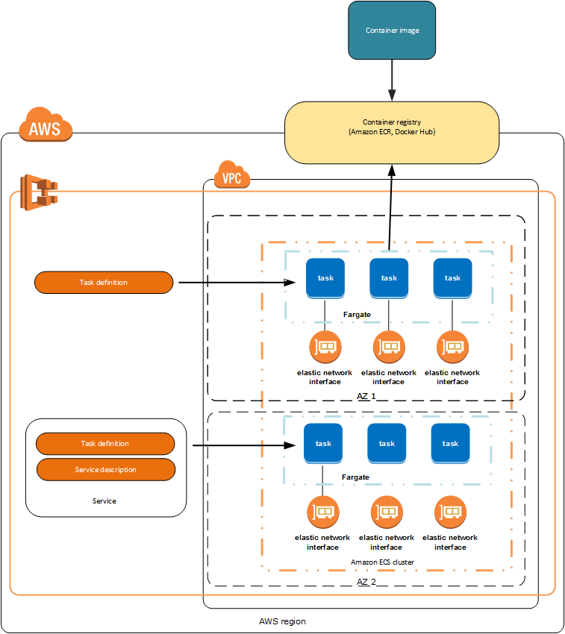
Amazon ECS launch type determines the type of infrastructure on which our tasks and services are hosted.
Fargate Launch Type
It helps us to run our containerized applications without the need to provision and manage backend infrastructure so what we need to do is just we should register our task definition and the fargate automatically launches the best container for us based on the needs that we have provided.

Slide 7
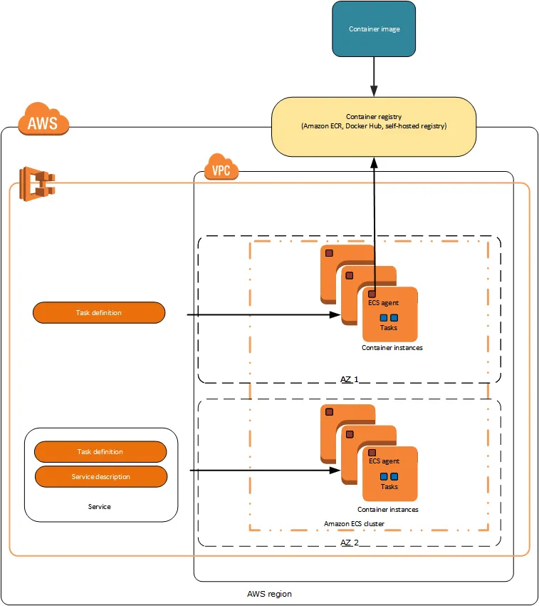
EC2 Launch Type
The EC2 launch type allows you to run your containerized applications on a cluster of Amazon EC2 instances that you manage.

Slide 8
In Amazon ECS there are some API calls using which we can launch and stop container based applications whenever we required and these API calls allows us to get the state of your cluster from a centralized service, and gives you access to many familiar Amazon EC2 features.
You can use Amazon ECS to schedule the placement of containers across your cluster based on your resource needs, isolation policies, and availability requirements. Amazon ECS eliminates the need for you to operate your own cluster management and configuration management systems or worry about scaling your management infrastructure.
Amazon ECS can be used to create a consistent deployment and build experience, manage, and scale batch and Extract-Transform-Load (ETL) workloads, and build sophisticated application architectures on a microservices model.

Slide 9
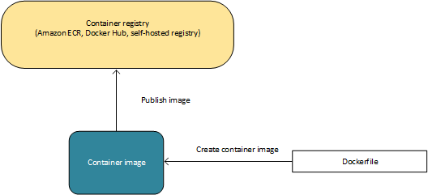
Containers & Images
To deploy or run any application in containers, the application components must be architected:
A Docker container is a standardized unit of software development, containing everything that your software application needs to run: code, runtime, system tools, system libraries, etc.
Containers are created from read-only template which is also called as Image.
The images are built from a docker file, a plain text file that specifies all of the components that are included in the container. These images are then stored in a registry from which they can be downloaded and run on your cluster.
Docker is a technology that allows you to build, run, test, and deploy distributed applications that are based on Linux containers.
Amazon ECS uses Docker images in task definitions to launch containers on Amazon EC2 instances in your clusters.

Slide 10
Task Definitions
Task definition is mandatory to run any application on Amazon ECS, except task definition remaining everything will be taken care by Amazon ECS. The task definition format is either in a text file or JSON format which describes one or more containers, the limit of creating containers is up to maximum of 10 that form your application also we can say that it is a blue print for your application.
There are different parameters that task definition will specify for your application.
The Docker image to use with each container in your task
How much CPU and memory to use with each task or each container within a task
The launch type to use, which determines the infrastructure on which your tasks are hosted
The Docker networking mode to use for the containers in your task
The logging configuration to use for your tasks
Whether the task should continue to run if the container finishes or fails
The command the container should run when it is started
Any data volumes that should be used with the containers in the task
The IAM role that your tasks should use
You can define multiple containers in a task definition. The parameters that you use depend on the launch type you choose for the task. Not all parameters are valid.

Slide 11
Task Definitions
Your entire application stack does not need to exist on a single task definition, and in most cases it should not. Your application can span multiple task definitions by combining related containers into their own task definitions, each representing a single component.
The following is an example of a task definition containing a single container that runs an NGINX web server using the Fargate launch type.
{
"family": "webserver",
"containerDefinitions": [
{
"name": "web",
"image": "nginx",
"memory": "100",
"cpu": "99"
},
],
"requiresCompatibilities": [
"FARGATE"
],
"networkMode": "awsvpc",
"memory": "512",
"cpu": "256",
}

Slide 12
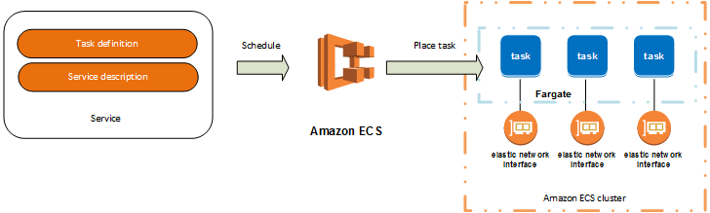
Task and Scheduling
After a successful creation of a task definition for your application we can specify, how many number of tasks that you need to run on you are cluster.
Each task that uses the Fargate launch type has its own isolation boundary and does not share the underlying kernel, CPU resources, memory resources, or elastic network interface with another task.
The Amazon ECS task scheduler is responsible for placing tasks within your cluster. There are several different scheduling options available. For example, you can define a service that runs and maintains a specified number of tasks simultaneously.

Slide 13
Clusters
A cluster is a logical grouping of resources.
When using the Fargate launch type with tasks within your cluster, Amazon ECS manages your cluster resources.
When using the EC2 launch type, then your clusters are a group of container instances you manage.
An Amazon ECS container instance is an Amazon EC2 instance that is running the Amazon ECS container agent. Amazon ECS downloads your container images from a registry that you specify, and runs those images within your cluster.

Slide 14
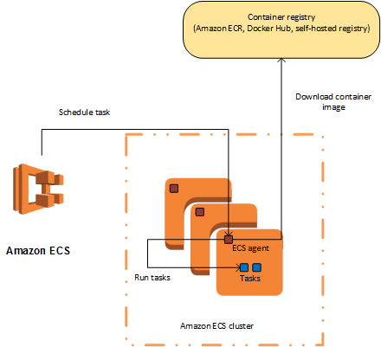
Container Agent
Container Agent
The container agent runs on each infrastructure resource within an Amazon ECS cluster.
It sends information about the resource’s current running tasks and resource utilization to Amazon ECS, and starts and stops tasks whenever it receives a request from Amazon ECS.

Slide 15
AWS Services used with ECS
Amazon ECS can be used along with the following AWS services:
AWS Identity and Access Management
In Amazon ECS, IAM can be used to control access at the container instance level using IAM roles, and at the task level using IAM task roles.
Amazon EC2 Auto Scaling
You can use Auto Scaling with a Fargate task within a service to scale in response to a number of metrics or with an EC2 task to scale the container instances within your cluster.
Elastic Load Balancing
You can use Elastic Load Balancing to create an endpoint that balances traffic across services in a cluster.
Amazon Elastic Container Registry
Amazon ECR is a managed AWS Docker registry service that is secure, scalable, and reliable. Amazon ECR supports private Docker repositories with resource-based permissions using IAM so that specific users or tasks can access repositories and images. Developers can use the Docker CLI to push, pull, and manage images.
AWS Cloudformation
You can define clusters, task definitions, and services as entities in an AWS CloudFormation script.

Slide 16
Access AWS ECS Services
Amazon Management Console
The console is a browser-based interface to manage Amazon ECS resources.
Amazon CLI
AWS command line tools can be used to issue commands at your system’s command line to perform Amazon ECS and AWS tasks; this can be faster and more convenient than using the console. The command line tools are also useful for building scripts that perform AWS tasks.
Amazon ECS CLI
It provides high-level commands to simplify creating, updating, and monitoring clusters and tasks from a local development environment using Docker Compose.
AWS SDK’s
SDKs that enable you to access Amazon ECS from a variety of programming languages. The SDKs automatically take care of tasks such as:
Cryptographically signing your service requests
Retrying requests
Handling error responses

Slide 17
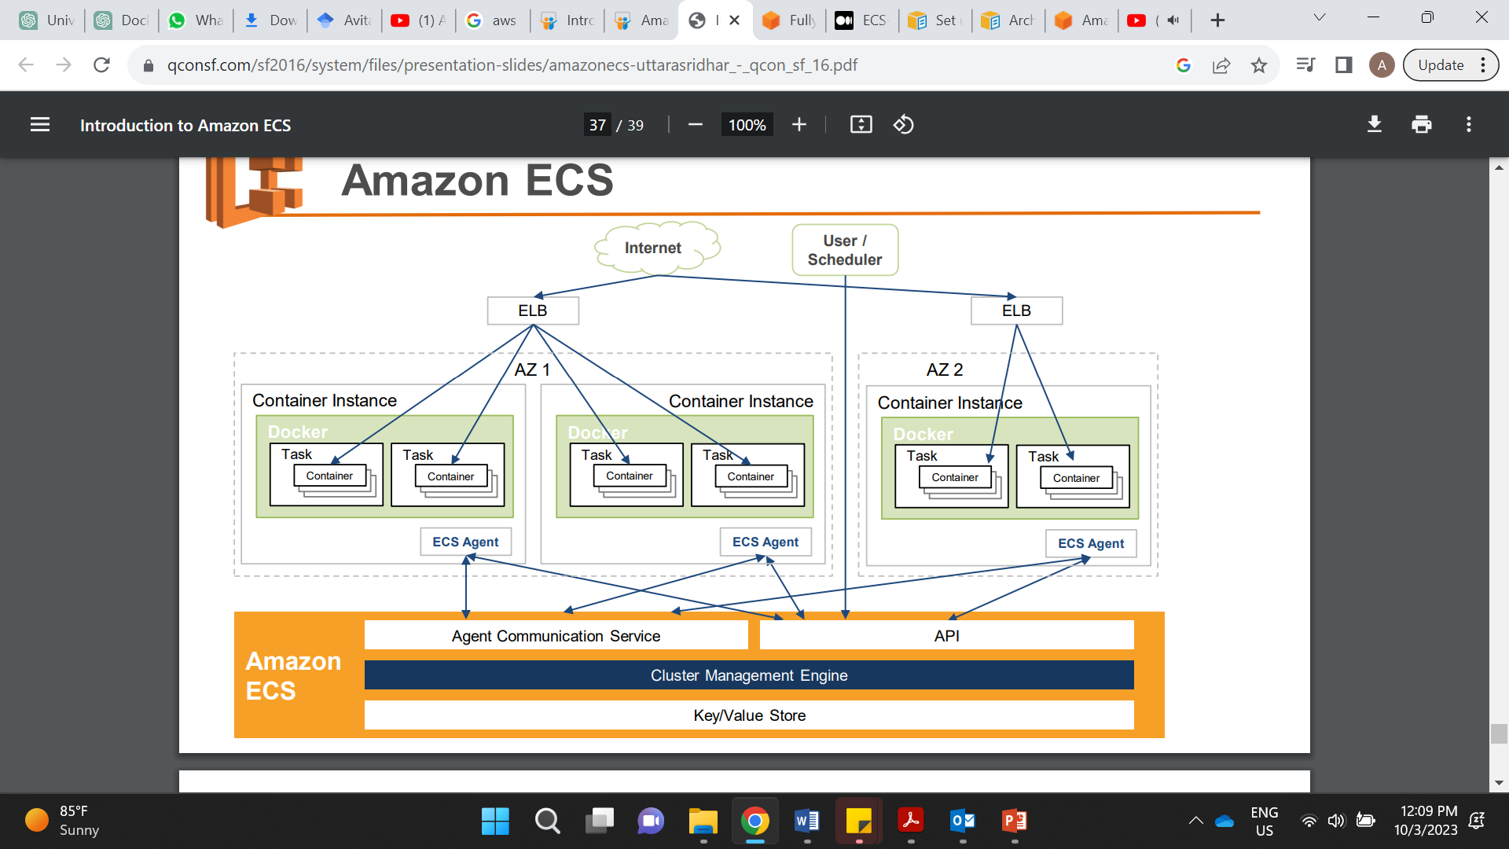

Slide 18
Demo
https://www.youtube.com/watch?v=46mFdtpy3NQ&t=1151s

